Slide 1
Five things I wish I knew before attempting to localize my scoped application
Maria Gabriela Ochoa Perez Waechter
Senior ServiceNow Developer
Jesalyn Smith
ServiceNow Developer

Slide 2


Who we are…
Jesalyn Smith
ServiceNow Developer
Maria Gabriela Ochoa Perez Waechter
Senior ServiceNow Developer
She/Her
ServiceNow Developer
https://jesalyn.dev
She/Her
2022 & 2021 ServiceNow Developer MVP
https://mgopw.dev

Slide 3
Back to basics real quick…
Localization vs Translation
Can’t ServiceNow do this?
Localization is making an application adaptable to specific regions without impacting functionality
Translation is changing source text into another language
That’s why we’re localizing our application!
Language pack plugins only cover OOB strings
Anything custom (everything in a scoped application!) needs to be self-localized
Notes:
Before we jump into the 5 things we wish we knew, let’s go back to the basics real quick to make sure we’re all at the same starting point
Making an application adaptable means:
Your application appears in the region’s target language
Your application displays the preferred:
Number, Date, Time format
Currency format
Choices based on location
Self-Localization can be done in different ways:
Manually
Humans source the translations
Machine
Google Translate
Dynamic Translation functionality in ServiceNow
We’re going to focus on manual localization since that’s the approach we took

Slide 4
Tools we recommend
OOB Tools
FetchCode
“Display translation prefix on translatable strings” (glide.ui.i18n_test) System Property
“Translate and learn” (glide.translate.learn) System Property
Crowdin
Localization management solution
Instance code search utility
Our GitHub repo!
Link at the very end 😉
Notes:
Here’s some tools that helped us localize our application. We recommend using them since they made this entire process easier
We’ll discuss each tool in more detail throughout the presentation but at a high level:
OOB Tools:
Translation prefix
This system property places a prefix like “MSG” before each string to tell you which table a string is on
Helps with debugging and identifying translation gaps
Translate and Learn
This system property will automatically create records in the applicable translation table for any strings that are missing translations
Helps with doing part of the work for you since you don’t have to create the records yourself, just need to update them with the translation value
Crowdin:
???
FetchCode:
Project on ServiceNow Share
Helps with identifying hard-coded strings
We inherited a lot of legacy code and didn’t know where all hard-coded strings are located within the app. Script Includes, Business Rules, Widgets, and every other place with a script field in the system is a huge effort to have to manually audit for hard-coded strings. So, we found this tool.
We use this to search for where code is in our instance. In a large scoped application with lots of legacy code, it’s likely you don’t know what code exists/is doing.
This tool makes it easy to search for where a function name or search term is being referenced in the system. For example, we’ve even used it to search for CSS classes to see if they were still being used in our app.

Slide 5
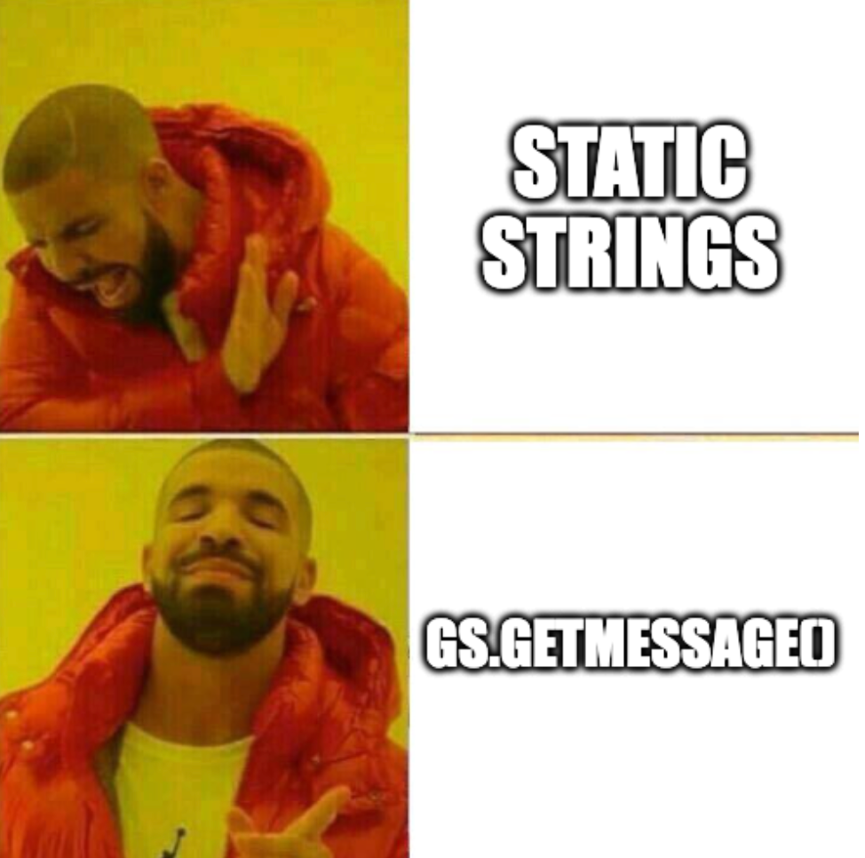
BEFORE YOU START
Plan the Localization Strategy
1
WHEN YOU START
Find Missing Translations
2
Establish Design and Development Standards
SOMEWHERE IN THE MIDDLE
Test the Localization Implementation
3
AFTER GO-LIVE
IN THE FUTURE
Maintain the Localization Implementation
4
5
Notes:
Now that we’ve covered the basics and some helpful tools, it’s time to learn about the 5 things I wish I knew before attempting to localize my scoped application
Where do I even start?
We’ve broken up the process of localizing your app into 5 steps
The 1st step happens before you start anything, where you need to plan the localization strategy
This means figuring out some details like:
What languages will you support
How will you source translations
In our case, we decided to focus on Spanish, French, German since that’s what customers requested
There are a few options for sourcing translations
Machine such as Google Translate
By hand with the help of native speakers or language leads / experts
For us, our team has native Spanish and French speakers, so we only had to figure out a plan for German translations. That’s where we went with the Crowdin tool
Now that you have a plan, you’re ready to start and so you activate the language plugin. During this stage of the process you should focus on finding missing translations.
Remember how ServiceNow doesn’t translate for you? In order for ServiceNow to display the translated text, there needs to be records of the strings in the 5 translation tables for the target language. This is where the OOB system properties comes into play.
“Translate and learn” will create these translation records for you, when it comes across a string that only has an English version. The best way to use this property is to literally click through every single thing in your application. We went module by module of our app in the filter navigator. Open a form on each table, including table sections. Click on choice fields. Visit every page in your Portal to capture text from widgets. With this method we were able to generate 100+ records that needed translations added.
Even though these records are now created, our work isn’t done finding missing translations. Any hard-coded string in your scripts will not be able to locate these translation records since they aren’t using the appropriate MessageAPI. All of these hard-coded strings will need to be converted.
This is when you want to enable the property we recommend “Displays translation prefix on translatable strings”. This property will tell you which table the string comes from. The important thing here is if you see a string that doesn’t identify which table it’s from, meaning it doesn’t have a prefix, then you know the string is hard-coded.
Another tool we used to find hard-coded strings is FetchCode. Our GitHub repo and blog post showcases how we used it.
By this point, you’re somewhere in the middle of converting your hard-coded strings to translatable ones. What’s the best way to do that? Establishing some Design and Development Standards can make life easier for future development, debugging, and maintenance.
We learned there’s a better way to use gs.GetMessage(). The common example you see with this method is placing the English text you want to display to the user as the key to the function call. For example, gs.getMessage(‘View your requests’)
However, we recommend that rather than using English text as a key, use a system description instead. For example, gs.getMessage(‘widget_request_title’). Then, your sys_ui_message translation record would have the key as widget_request_title, and value of View your requests.
Structuring your code like this makes it easy to tell when this string is missing a translation record because the output will show ‘widget_request_title’ rather than ‘View your requests’
More standards discussed in GitHub / blog post
With everything localized, it’s time to test all of the hard work done so far.
We don’t have a well-defined testing plan, partly since we haven’t reached this stage ourselves yet.
However, what we have done is taken a look at everything in our application to see how it looks when things are translated.
Different languages have different sizing compared to English, so what looks good in the English UI might appear cramped or overflowing in the translated UI. For example, the word for “New” is 3 letters long in English but 9 letters long in French. This is something to be mindful of, especially when users are zoomed in to their browsers or have a larger default font size.
Another thing we plan to do is have our customers try to navigate our application in English, and then in the target language like French. Using our Service Portal as an example, our goal is to verify that our customers can navigate and use the portal functionality the same as in English vs. French.
If our customers are unable to use the French version of the portal for whatever reason, that gives feedback for what needs to be re-worked
Great job! The localization implementation has been deployed. Now it needs to be maintained.
Like testing, we also don’t have a well-defined maintenance plan, since we haven’t reached this stage ourselves yet.
When new content and features get added to the app, localization needs to be considered. Code reviews should be checking that strings aren’t hardcoded for instance.
A good thing about making sure you’re not hard-coding strings and wrapping everything in the appropriate gs.GetMessage in your scripts is that this makes maintenance of your strings easier!
Whenever you want to change the wording of a message, you no longer need to change the code. You can instead update the value of the translation record for that key which is a data change.

Slide 6



Thank you!
https://WomenNow.Dev
Resources and more in our GitHub repo: https://github.com/WomenNowDev/SNAppLocalization
Come hang out with us @ https://sndevs.com
Notes:
View our GitHub repo and blog post on this topic. It goes way more in depth on what we’ve covered today and has code samples that you can reference

